Slide 1
Lecture 5 The Market Forces of Supply and Demand

Slide 2
The Market Forces of Supply and Demand
Supply
The quantity supplied of any good or service is the amount that sellers are willing and able to sell.
The quantity supplied is the number of units that sellers want to sell over a specified period of time at a particular price.

Slide 3
The Market Forces of Supply and Demand
Law of Supply
The law of supply states that all other things remaining unchanged, the quantity supplied of a good increases as its price increases the quantity supplied of a good decreases as its price decreases.
When the price of a commodity is raised, other things remain constant, sellers tend to sell more of the commodity and vice versa.

Slide 4
The Market Forces of Supply and Demand
Supply Schedule and Supply Curve
Supply Schedule:
A supply schedule is a list showing the amount of a product that producers would produce and sell at a series of varying prices, during a certain time, with all the other factors held constant.
Supply Curve:
A supply curve is a graphical representation of the relationship between the quantity supplied of a good that producers are willing and able to sell and the price of the good, holding constant all other variables that influence supply.

Slide 5
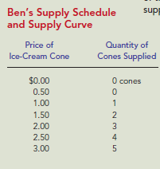
The Market Forces of Supply and Demand
Supply Schedule
Supply schedule is a table that shows the relationship between the price of a good and the quantity supplied of that good.

Slide 6
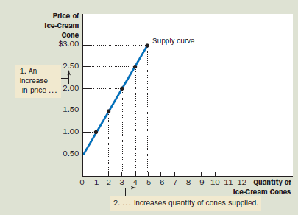
The Market Forces of Supply and Demand
Supply Curve
Supply curve is a graph that shows the relationship between the price of a good and the quantity supplied of that good.

Slide 7
The Market Forces of Supply and Demand
Why Most Supply Curves Are Upward Sloping
Most supply curves are upward sloping. The fundamental reason for this involves the law of diminishing marginal returns.
Generally, though, producing more of a good does not come with constant per-unit costs. In other words, the increased production of a good comes at increased opportunity costs.
An upward-sloping supply curve simply reflects the fact that costs rise when more units of a good are produced. So, an upward-sloping supply curve reflects the fact that, under certain conditions, a higher price is an incentive to producers to produce more of the good.

Slide 8
The Market Forces of Supply and Demand
Market Supply versus Individual Supply
The supply curve in Figure 5 shows an individual’s supply for a product.
To analyze how markets work, we need to determine the market supply, the sum of all the individual supplies for a particular good or service.
The table in Figure 6 shows the supply schedules for ice cream of the two individuals in this market - Ben and Jerry. The market supply at each price is the sum of the two individual supplies.

Slide 9
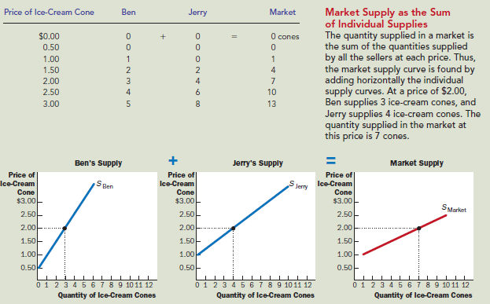
The Market Forces of Supply and Demand
Market Supply versus Individual Supply

Slide 10
The Market Forces of Supply and Demand
Market Supply versus Individual Supply
Notice that in Figure 6, we sum the individual supply curves horizontally to obtain the market supply curve.
Because we are interested in analyzing how markets function, we work most often with the market supply curve.
The market supply curve shows how the total quantity supplied of a good varies as the price of the good varies, while all the other factors that affect how much sellers want to sell are held constant.

Slide 11
The Market Forces of Supply and Demand
Determinants of Supply
What factors determine how much ice cream will a producer supply?
Price of the good itself
Input prices
Technology
Govt. policy
Expectations
No. of sellers
Natural Calamities
Movement Factor
Shift Factors

Slide 12
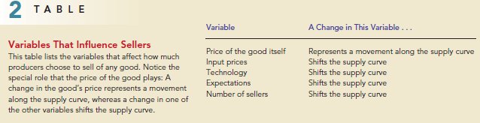
The Market Forces of Supply and Demand
Determinants of Supply
Table 2 lists the variables that influence how much producers choose to sell of a good.

Slide 13
The Market Forces of Supply and Demand
Movement along the Supply Curve or A change in Quantity Supplied
A change in quantity supplied is however reflected in a movement along the supply curve and is called an extension or a contraction in quantity supply.
The movement along the supply curve is due to the change in price of the good while all other factors remaining unchanged.

Slide 14
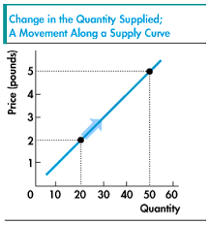
The Market Forces of Supply and Demand
Movement Along the Supply Curve or A change in Quantity Supplied

Slide 15
The Market Forces of Supply and Demand
Shift of the Supply Curve or Change in Supply
A change in supply is reflected by shift of the supply curve and is called an rise or a fall in supply.
The shift of the supply curve is caused by a change in any of the non-price determinants (Input price, Technology, Weather, Expectations, Number of sellers etc.) of supply.

Slide 16
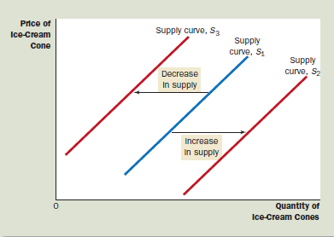
The Market Forces of Supply and Demand
Shift of the Supply Curve or Change in Supply

Slide 17
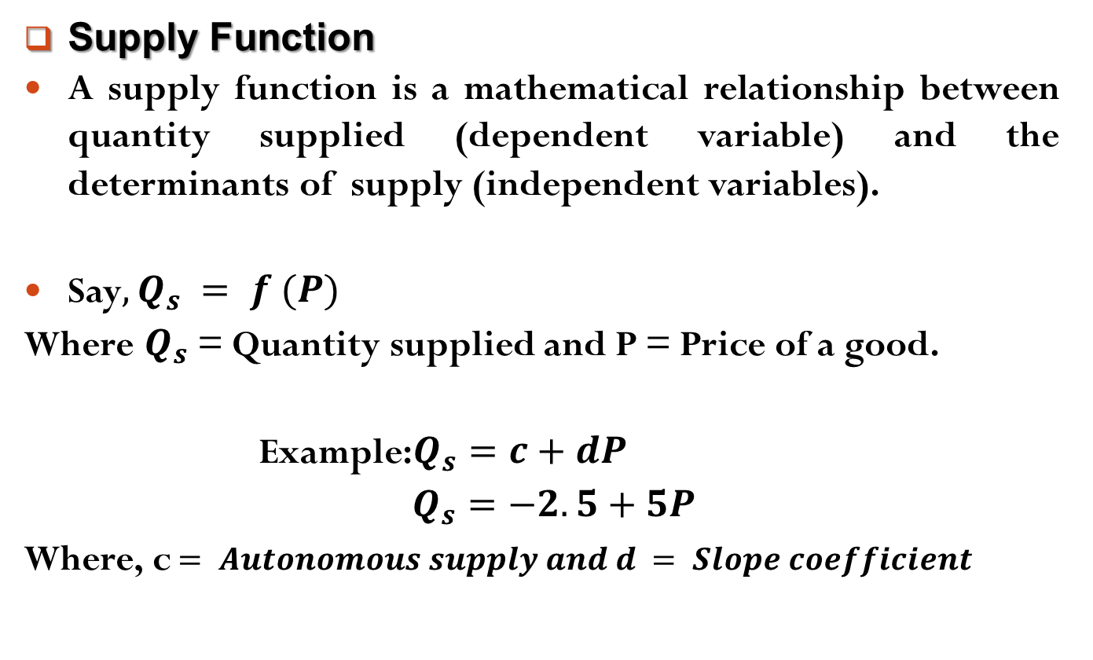
The Market Forces of Supply and Demand
Supply Function
A supply function is a mathematical relationship between quantity supplied (dependent variable) and the determinants of supply (independent variables).
Say$, Q_{s} = f (P)$
Where $Q_{s}$= Quantity supplied and P = Price of a good.
Example:$Q_{s}=c+dP$
$Q_{s}=−2.5+5P$
Where, c$= Autonomous supply and d = Slope coefficient$

Slide 18

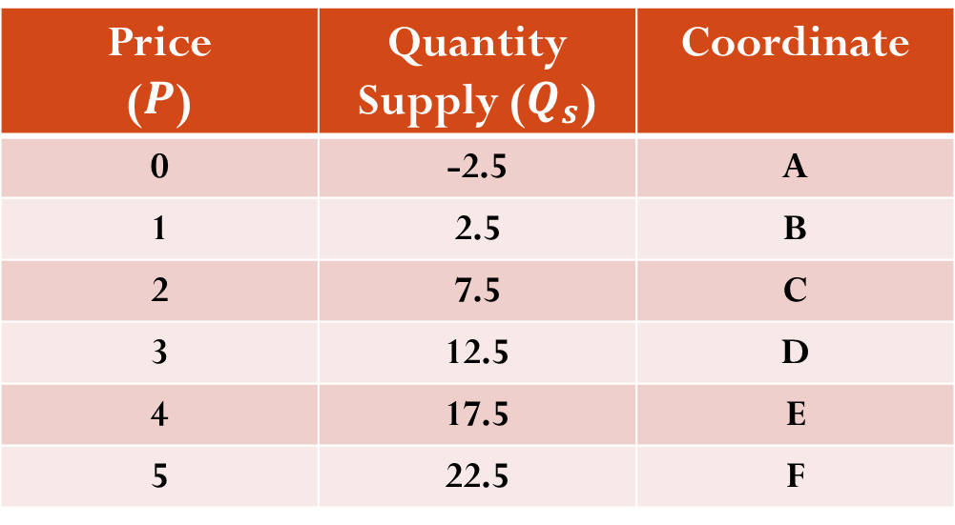
The Market Forces of Supply and Demand
Supply Function
Example: $Q_{s}=−2.5+5P$
Supply Schedule from a Supply Function
Price ($P$) | Quantity Supply ($Q_{s}$) | Coordinate
0 | -2.5 | A
1 | 2.5 | B
2 | 7.5 | C
3 | 12.5 | D
4 | 17.5 | E
5 | 22.5 | F

Slide 19

The Market Forces of Supply and Demand
Supply Function
Example: $Q_{s}=−2.5+5P$
Supply Curve from a Supply Function
Price
5
4
3
2
1
0
S
F
E
D
C
B
A
-2.5 2.5 7.5 12.5 17.5 22.5
Quantity Supplied

Slide 20
Readings
N. G. Mankiw- Principles of Microeconomics, 5th Edition, Chapter – 4.
Roger A. Arnold- Microeconomics, 10th Edition, Chapter – 2.

Slide 21


Slide 22
Thank You

